Slide 1

Amadeus Interface Record (A.I.R) for Back-Office
Strictly
CONFIDENTIAL
Newcomer presentation

Slide 2





Introduction
Positioning
It’s an essential product in the Electronic Ticketing portfolio. But it’s also used for non-ticketing activities
It captures booking elements and ticketing elements from the PNR and interacts with the mid/back-office system
It’s used by all types of travel agencies worldwide for:
  Accounting/Invoicing
  Quality control
  Statistics
  Other applications (like mobile app)
Reservation
Ticketing
Mid/Back-Office
Travel Agent
Create/modify PNR
Issue/modify documents
Invoicing, Accounting
Statistics

Slide 3
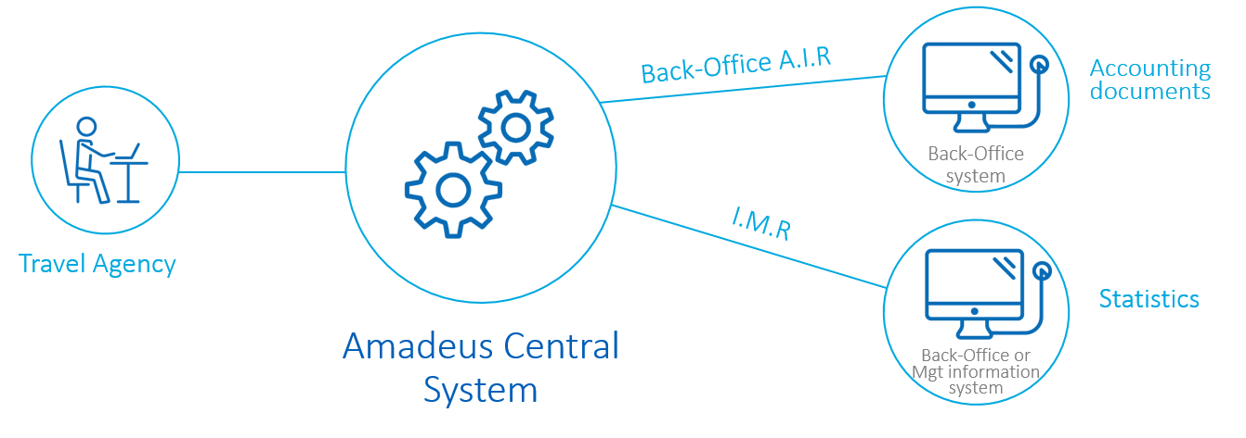
Introduction
What is it?
Amadeus Interface Records are pseudo-Edifact messages sent from Amadeus Central System to the agencies back-office accounting and data management systems, in real-time
Two types of messages:
  Back-Office A.I.Rs (Amadeus Interface Records) are triggered at document issuance time (and follow-up actions) automatically or can be generated manually (TTP/BTK)
  IMRs (Information Management Records) are triggered by the creation/modification of Amadeus PNRs, automatically or manually (BT)
Notes:
Pseudo-Edifact message: AIRRQT type
AIRs are used for invoicing by the accounting system (also called back-office AIRs)
IMRs are used for statistical purposes or quality control, and now for mobile applications

Slide 4
Triggers & Content
Triggers and content are customisable via the office profile
The triggers you can define which type of AIR/IMR you want to generate
The content: you can define which data you want to include in the A.I.R.
It can also be defined in a customization key which overrides office profile settings. The key enable the agent to benefit from data without the need to upgrade version. The same key can be used for several offices (very useful for big corporations, TMCs).
This is usually done by the ACO via a UI (‘customisation tool’).
It’s used by all Amadeus products (A.I.R.s can be generated for air, non-air, miscellaneous segments, e-ticketing, EMD, light ticketing, offers, etc)
Notes:
Type of AIR examples: refund AIR, void, Rail , CVP, etc

Slide 5
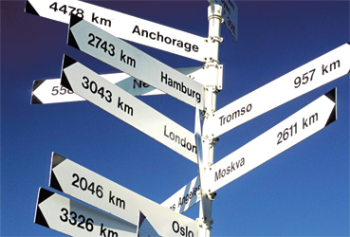

Multi-destination product
Mirror vs. Shadow
It can be sent to several destinations (primary or secondary):
  Mirror process: copy of A.I.R where triggers and content are decided by the mirror office
  Shadow process: copy of A.I.R where triggers come from the origin office. Can be customised by the receiving office
Origin
Mirror/Shadow
Primary
Mirror/Shadow
Notes:
Origin office is the office generating the data (by creating, modifying PNRs and issuing documents) = booking office/ticketing office
Primary office is the accounting office (can be different from the origin)
The mirror and shadow offices are defined in the origin office (MIO and SAO fields in the PVA)

Slide 6
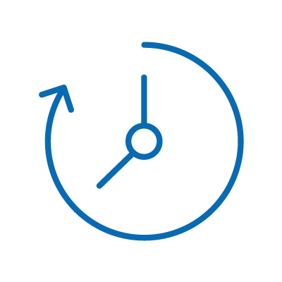


Retention process
Once an A.I.R/I.M.R has been created by the system, a retention process starts:
the records are kept 28 days
During that period, the A.I.R/I.M.R can be displayed or manually retransmitted if needed

Slide 7
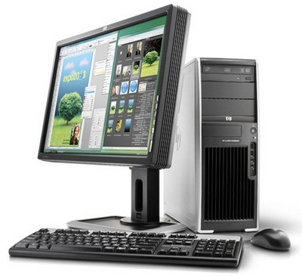
Cryptic entries
Several cryptic entries are available for the agents. They are controlled by LSS permissions
TTZB
Display A.I.R / I.M.R (for helpdesk only)
BD
Display list of A.I.Rs/I.M.Rs
BG
Display generated A.I.Rs/I.M.Rs from a specific PNR
BR
Retransmit
BT
Generate manual IMR
BB / BASTART / BSSTOP
Display, start, stop
transmission queue
Notes:
Other entries exist to manage AIRs
LSS permissions have replaced the usergroup transaction security

Slide 8
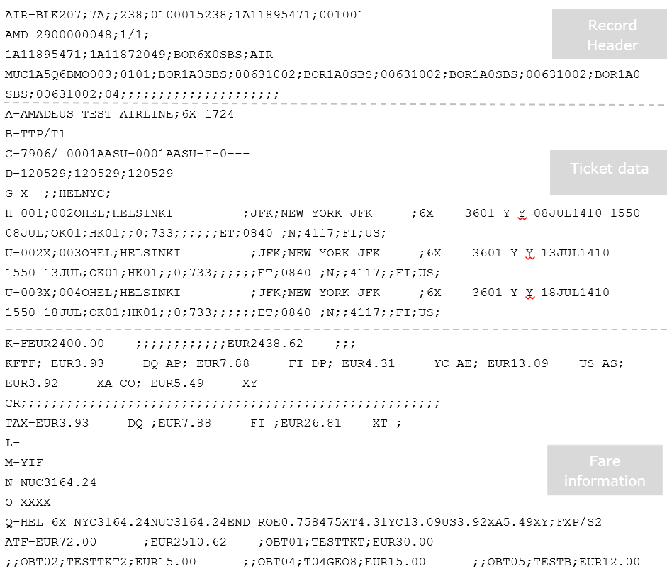
Sample

Slide 9
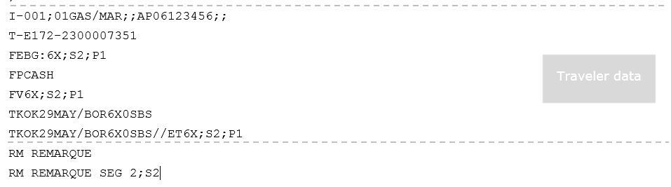
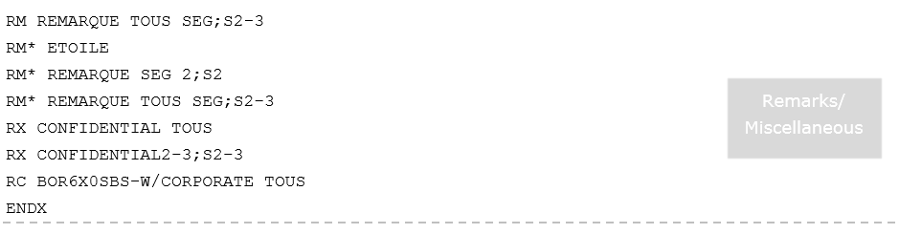
Sample

Slide 10
BO A.I.R - Product Positioning
Introduction
A review on similar products like AIR/IMR, Amadeus Booking Data Feed (ex-IMR Premium) and TTR Feed was performed
The objective was to compare products, clarify product positioning, find synergies, eliminate duplication, coordinate and anticipate impacts on other products
ABDF
Back-Office A.I.R
TTR Feed
I.M.R

Slide 11
Comparison of the feeds (1/2)
ABDF
Back-Office A.I.R
TTR Feed
I.M.R
Description | Rich and customisable PNR data feed to client’s IT system | Transaction activity from PNR, TST, TSM to generate structured data to back-office systems | Transaction activity from PNR to generate structured data and statistics to BOS or IT systems | Complementary data feed to provide extended data stored in the TTR
Usage | Quality control, customer notifications, MBO feeding | MBO feeding for invoicing and accounting purposes | Compile statistical or management information reports | Feeding MBO and Reporting systems
Data transferred | PNR, Ticketing and DCS data | PNR, Ticketing | PNR, Ticketing | TTR: ETR, FI, Stakeholders, Packages, remarks, attachment, travel requests, extended offers
Data format | True Edifact or Embedded XML | Pseudo-Edifact | Pseudo-Edifact | Native XML
Delivery | Batch or Real-time | Real-time | Real-time | Batch or Real-time
Customization | Content + Triggers + output + sending mode * | Content + Triggers + multi destination | Content + Triggers + multi destination | Triggers
Notes:
* Sending mode: Feed sent daily or in real-time

Slide 12
Thank you!
© 2014 Amadeus IT Group SA
amadeus.com
Amadeus.com/blog
You can follow us on:
AmadeusITgroup

